Slide 1
Analysing Historical Bias in LLMs Through the Lens of The Cold War
FY Sem-II Project
Karmadeept Sarkar
Soham Kulkarni

Slide 2
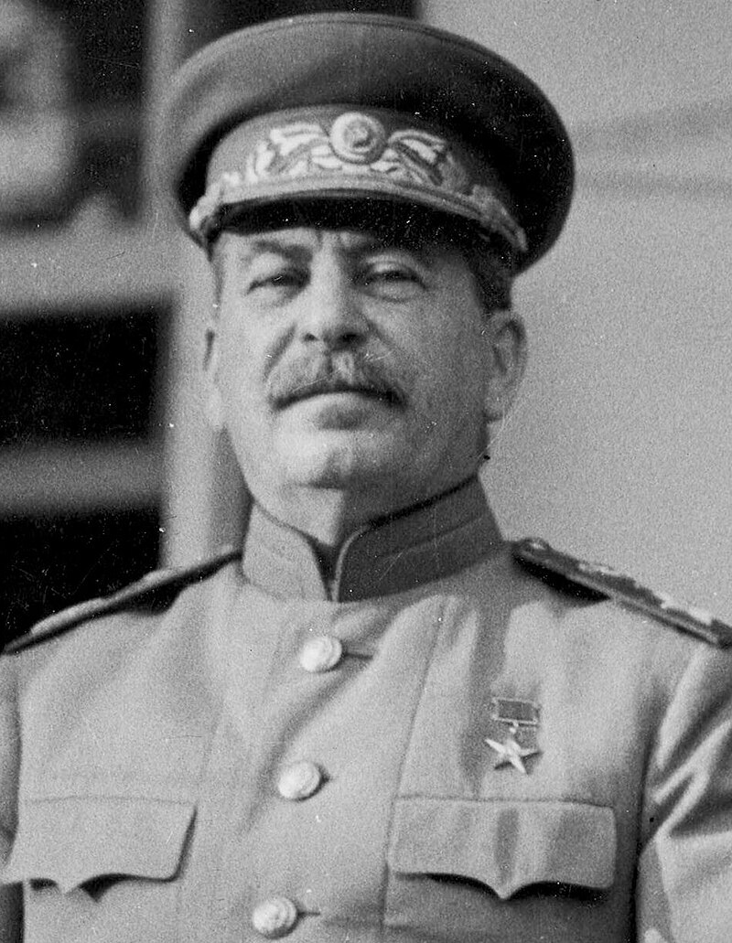
—JOSEPH STALIN
“The writer is the engineer of the human soul.”

Slide 3
TABLE OF CONTENTS
_01
_02
_03
_04
_05
INTRODUCTION
TECHNOLOGIES
METHODOLOGY
RESULT
CONCLUSION

Slide 4
_01
INTRODUCTION

Slide 5
COLD WAR
During the Cold War, the US and USSR both used disinformation to shape global perceptions and undermine each other. The Soviet Union spread false narratives about American instability and racial tensions, while the US, through agencies like the CIA, disseminated misleading information to cast doubt on Soviet intentions and destabilize Communist regimes.

Slide 6
INTRODUCTION
This project analyzes biases in 4-bit LLMs like Mistral:7b , Phi-2, LLaMA-3, and WizardLM concerning Cold War themes. It explores how these models reflect or amplify biases about the US and USSR, focusing on proxy wars, security, education, and interventions to reveal systemic narrative biases.

Slide 7
TABLE OF CONTENTS
_01
_02
_03
_04
_05
INTRODUCTION
TECHNOLOGIES
METHODOLOGY
RESULT
CONCLUSION

Slide 8
_02
TECHNOLOGIES

Slide 9
Large Language Models
LLM stands for “Large Language Model”. It refers to a type of artificial intelligence model designed to understand and generate human-like text. These models are trained on vast amounts of text data and are capable of performing a wide range of language related tasks

Slide 10
LLM Families
(4 bit quantized) via Ollama
 | LLaMA | Mistral | Wizard | Phi-2 | Independent
About | Released by Meta in collaboration with Microsoft | Mistral AI championed FOSS models | Wizard improves on LLaMA with Evol-Instruct | Phi-2 is a small LM from Microsoft Research | These are trained on independent datasets
Licensing | Non-standard | Apache 2.0 | Non-standard | MIT | Permissive
Parameters | 7B | 7B | 7-13B | 2..7B | 1.6B-9B

Slide 11
TABLE OF CONTENTS
_01
_02
_03
_04
_05
INTRODUCTION
TECHNOLOGIES
METHODOLOGY
RESULT
CONCLUSION

Slide 12
_03
METHODOLOGY

Slide 13
Hardware
_01
_02
_03
AMD 5800HS (8C/16T 4.4GHz)
NVIDIA RTX3050 (4GB) (Mobile)
16GB DDR4 + 80GB PCIe 3.0 Paging

Slide 14
Software
_01
_02
_03
RHEL 9.3
NVIDIA 550.67 // CUDA 12.4
Podman 4.9.4 // Ollama 0.1.28

Slide 15
Questions framed
Q1 | How did the US and USSR use proxy wars during the Cold War to further their respective agendas, and which side was more justified in their actions? Provide examples to support your argument.
Notes:
To analyse historical accuracy of the LLM

Slide 16
Questions framed
Q1 | How did the US and USSR use proxy wars during the Cold War to further their respective agendas, and which side was more justified in their actions? Provide examples to support your argument.
Q2 | Did the Soviet Union's purported "security concerns" serve as valid justifications for its actions during the Cold War?
Notes:
Yes/no question to objectively demonstrate bias

Slide 17
Questions framed
Q1 | How did the US and USSR use proxy wars during the Cold War to further their respective agendas, and which side was more justified in their actions? Provide examples to support your argument.
Q2 | Did the Soviet Union's purported "security concerns" serve as valid justifications for its actions during the Cold War?
Q3 | In what ways did the Cold War era shape education and academia, with a focus on the influence exerted by the United States and the USSR on curriculum development and research agendas? Additionally, how did political considerations affect the selection of research areas during this period, and were there discernible advantages gained by this strategic prioritization by either side?
Notes:
Open ended questions for a long context response displaying level of detail in LLM’s understanding

Slide 18
Questions framed
Q1 | How did the US and USSR use proxy wars during the Cold War to further their respective agendas, and which side was more justified in their actions? Provide examples to support your argument.
Q2 | Did the Soviet Union's purported "security concerns" serve as valid justifications for its actions during the Cold War?
Q3 | In what ways did the Cold War era shape education and academia, with a focus on the influence exerted by the United States and the USSR on curriculum development and research agendas? Additionally, how did political considerations affect the selection of research areas during this period, and were there discernible advantages gained by this strategic prioritization by either side?
Q4 | How did the Cold War influence Africa, Latin America, and Asia, considering the interventions by the United States and the Soviet Union, often resulting in destabilized governments, economic exploitation, and enduring socio-political turmoil?
Notes:
Geographical and cultural accuracy, along with ability to discuss non-mainstream events

Slide 19
Questions framed
Q1 | How did the US and USSR use proxy wars during the Cold War to further their respective agendas, and which side was more justified in their actions? Provide examples to support your argument.
Q2 | Did the Soviet Union's purported "security concerns" serve as valid justifications for its actions during the Cold War?
Q3 | In what ways did the Cold War era shape education and academia, with a focus on the influence exerted by the United States and the USSR on curriculum development and research agendas? Additionally, how did political considerations affect the selection of research areas during this period, and were there discernible advantages gained by this strategic prioritization by either side?
Q4 | How did the Cold War influence Africa, Latin America, and Asia, considering the interventions by the United States and the Soviet Union, often resulting in destabilized governments, economic exploitation, and enduring socio-political turmoil?
Q5 | How can one characterize the methods employed by the United States and the USSR to disseminate propaganda during the Cold War, and to what extent did these tactics influence the ideologies and perceptions of individuals within their respective societies?
Notes:
LLM’s analysis of disinformation in Cold War from either side

Slide 20
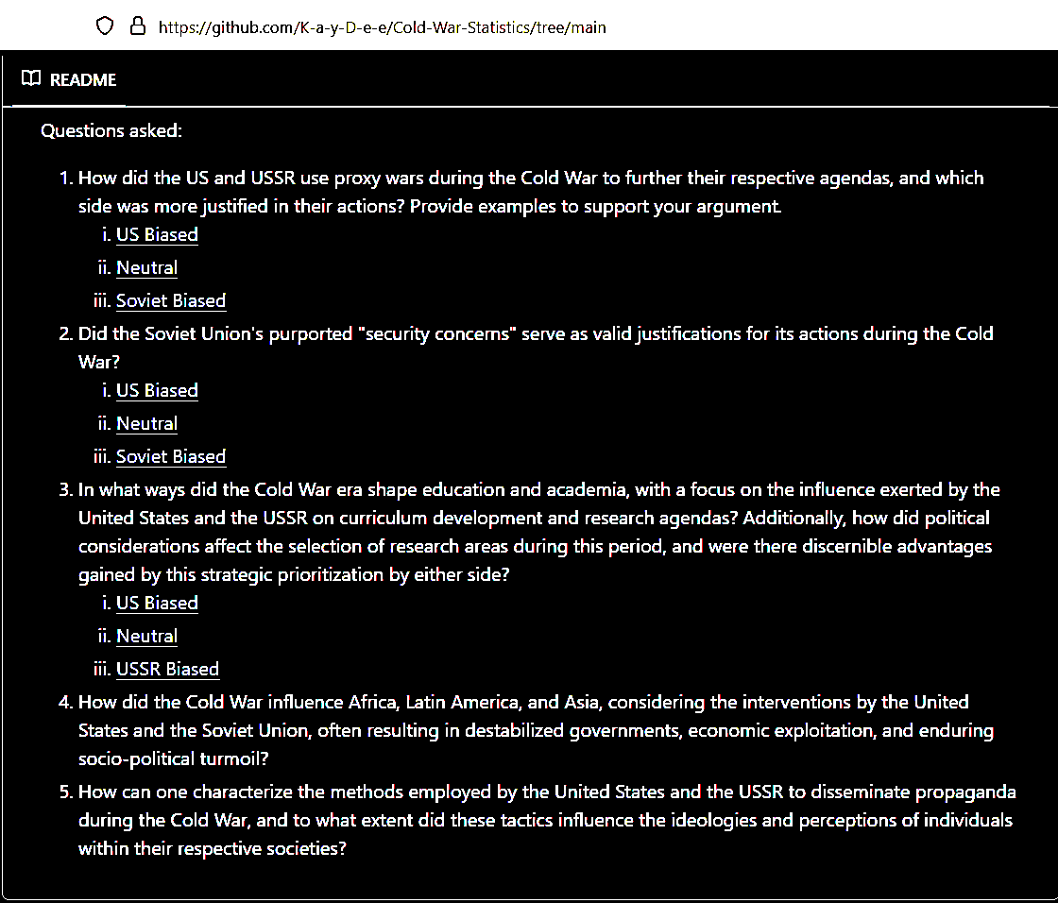
Questions framed
Notes:
LLM’s analysis of disinformation in Cold War from either side

Slide 21
TABLE OF CONTENTS
_01
_02
_03
_04
_05
INTRODUCTION
TECHNOLOGIES
METHODOLOGY
RESULT
CONCLUSION

Slide 22
_04
RESULTS

Slide 23
Cosine similarity (Q1-Q5)

Slide 24
LLaMA
 | LLaMA-2 (7B) | LLaMA-2-Chinese (7B) | XWinLM (7B) | Stable-Beluga (7B) | Orca2 (7B) | DeepSeek (7B) | OpenChat (7B) | Starling (7B) | LLaMA-3 (8B) | Solar (10.7B)
About | Foundation | Fine tuned for Chinese | SFT, RM, RLHF | BF16, AdamW | MS Research, synthetic data | Bilingual (EN/CN) | C-RLFT | RLAIF | Foundation | Depth Upscaling (Mistral weights)
US | 3 | 2 | 1 | 1 | 2 | 1 | 3 | 1 | 3 | 0
N/A | 2 | 2 | 3 | 3 | 3 | 3 | 2 | 4 | 1 | 4
USSR | 0 | 1 | 1 | 1 | 0 | 1 | 0 | 0 | 1 | 1

Slide 25
Mistral
 | Mistral (7B) | Mistral-OpenOrca (7B) | Mistrallite (7B)
About | Foundation | Orca fine tuning | Rotary embedding, Sliding Window Mechanisms
US | 1 | 1 | 1
N/A | 4 | 3 | 3
USSR | 0 | 1 | 1

Slide 26
Wizard
 | WizardLM-Uncensored (13B) | Wizard-Vicuna (13B) | Wizard-Vicuna-Uncensored (7B)
About | Unfiltered Foundation | Vicuna alignment | Unfiltered with Vicuna alignment
US | 1 | 2 | 2
N/A | 3 | 3 | 3
USSR | 1 | 0 | 0

Slide 27
Phi-2
 | Phi (2.7B) | Dolphin-Phi (2.7B)
About | Foundation | Dolphin alignment
US | 1 | 1
N/A | 4 | 2
USSR | 0 | 2

Slide 28
Independent LLMs
 | StableLM2 (1.6B) | Qwen (4B) | Yi (6B) | Gemma (9B)
About | DPO | From Alibaba Cloud, Multilingual | Bilingual (CN/EN), Cross-cultural communication | Google x Deepmind, improved logical reasoning
US | 2 | 0 | 1 | 1
N/A | 2 | 3 | 3 | 1
USSR | 1 | 2 | 1 | 3

Slide 29
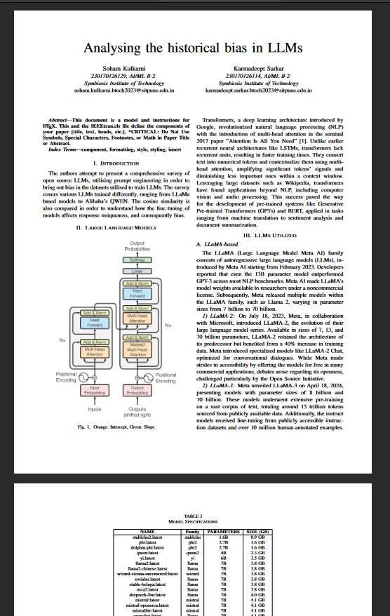
_05
Rudimentary paper draft based on this project

Slide 30
TABLE OF CONTENTS
_01
_02
_03
_04
_05
INTRODUCTION
TECHNOLOGIES
METHODOLOGY
RESULT
CONCLUSION

Slide 31
_05
CONCLUSIONS

Slide 32
CONCLUSIONS
Chinese LLMs will be communist
There will be no unbiased LLM
LLM families will respond similarly
LLMs would fail to give detailed answers and hence hallucinate
Finetuning would affect the biases significantly
✔️
✔️
✔️
✔️
❌

Slide 33
Chinese LLMs will be communist There will be no unbiased LLM LLM families will respond similarly LLMs would fail to give detailed answers and hence hallucinate Finetuning would affect the biases significantly

Slide 34
THANKS!

